Slide 1
Monetary policy and financial stability
David Vestin
2016-11-28

Slide 2
Introduction
Financial stability (FS) always been part of core business for central banks
Degree of responisibility differs across countries
Micro and macroprudential regulation promotes FS
Question: Use monetary policy for FS risks?

Slide 3
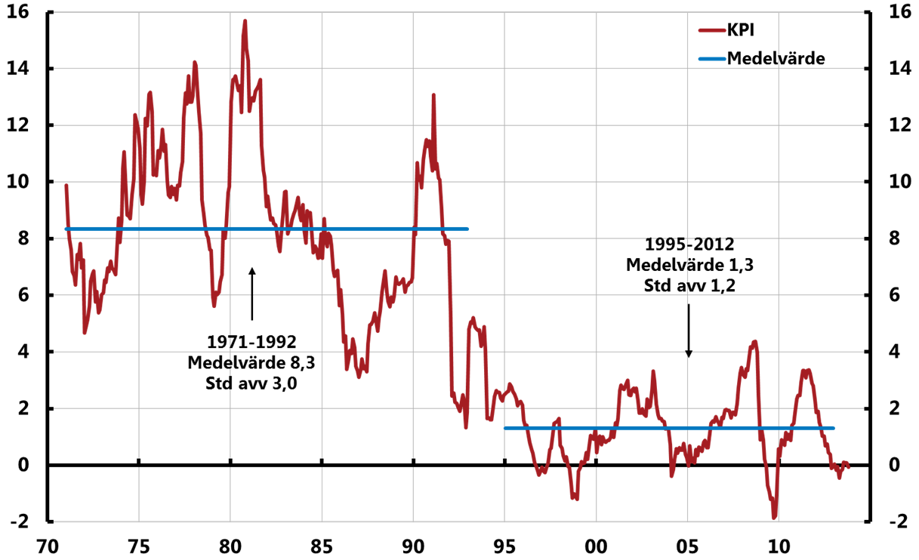
Why focus on price-stability?
CPI – annual percentage change
Source: SCB and Riksbank

Slide 4
Why does the monetary policy mandate focus on price stability?
High and volatile inflation 1960-80
Back then, belief in long-run trade-off : pi = … - u
  Conclusion: average u low if average inflation high
RE-revolution: Lucas, Sargent, Barro-Gordon
  Monetary policy lacks long-run real effects
  Political business-cycles creates short-run losses
Conclusion: delegate MP to independent central bank
  Provide ”nominal anchor”
  Sticky prices and wages -> monetary policy can influence real interest rates and thereby economic activity and prices

Slide 5
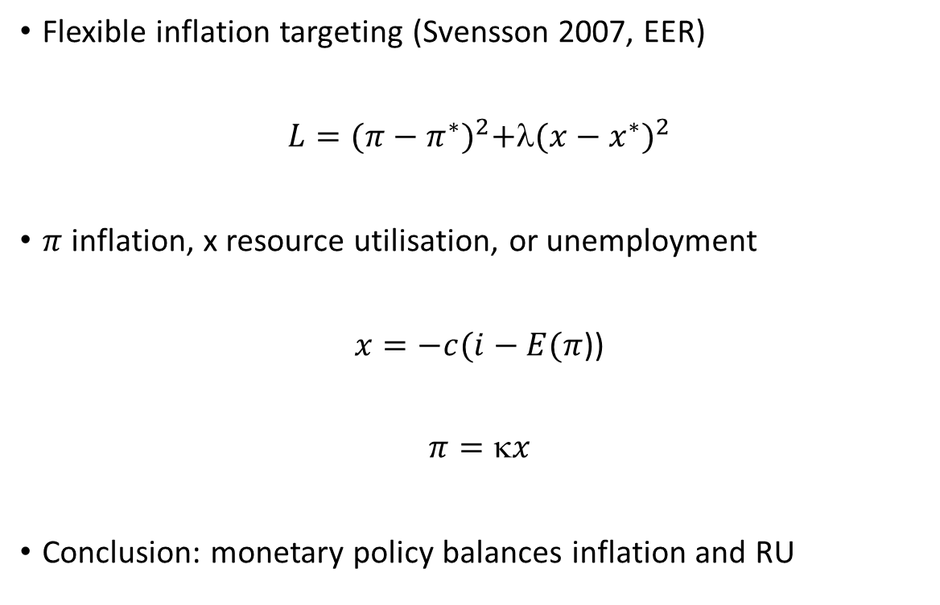
Pre-crisis monetary policy framework
Flexible inflation targeting (Svensson 2007, EER)
$L={(π−π^{∗})}^{2}+$λ${(x−x^{∗})}^{2}$
$π$ inflation, x resource utilisation, or unemployment
$x=−c(i−E(π$))
$$π=x$$
Conclusion: monetary policy balances inflation and RU

Slide 6
Strong growth in Swedish house-prices, fundamentals or bubble?

Slide 7
Household debt to income

Slide 8
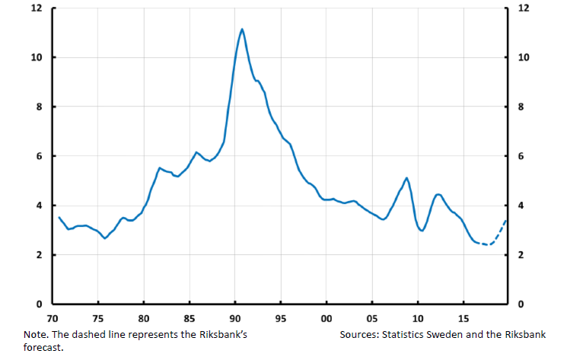
Interest expenditure/income

Slide 9
Financial stability
Narrow definition: ”Banking system reasonably robust”
Broader definition: ”Financial system reasonably robust”

Slide 10
Conclustions from financial crisis
”Great moderation” did not prevent crisis
First line of defence: micro+macropru
Cross-border resolution, banking union
But also: rethink framework for conduct of MP?
  Give new mandate + new tools (uncontroversial)
  Use interest rates to contain FS-risk (controversial)

Slide 11
Monetary policy effects on imbalances
Low interest rates might
stimulate (unsustainable?) debt growth
Induce ”search-for-yield” behavior
Possible first-best: other tools added to deal with unwarranted side-effects of monetary policy

Slide 12
Rethinking the monetary policy framework - Smets (2013)
Modified Jackson Hole consensus
Leaning agains the wind vindicated
Financial stability is price stability

Slide 13
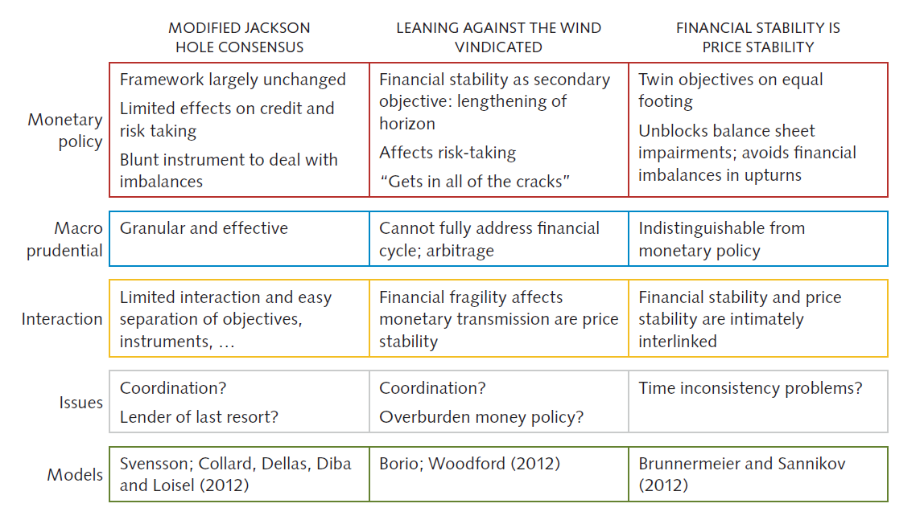
Smets (2013)

Slide 14
Smets three questions
How effective is macropru to ensure financial stability?
How significant is the effects of monetary policy on financial stability?
What is the risk of ”financial dominance”

Slide 15
Schematic outline: concern for imbalances
Macro-pru
Risk-taking
Source: The Riksbank

Slide 16
1. Modified Jackson-hole consensus
Macro-pru
Risk-taking
Source: The Riksbank

Slide 17
2. Leaning against the wind vindicated
Macro-pru
Risk-taking
Source: The Riksbank

Slide 18
3. Financial stability is price stability
Brunnemeier and Sannikov: I(ntermediation)-theory of money
In bad scenario, dinancial intermediation can be impeded
Monetary policy works through banks
  Lower interest rates raises bond prices, recapitalizes banks
In this setting, monetary policy works by stabilizing banks

Slide 19
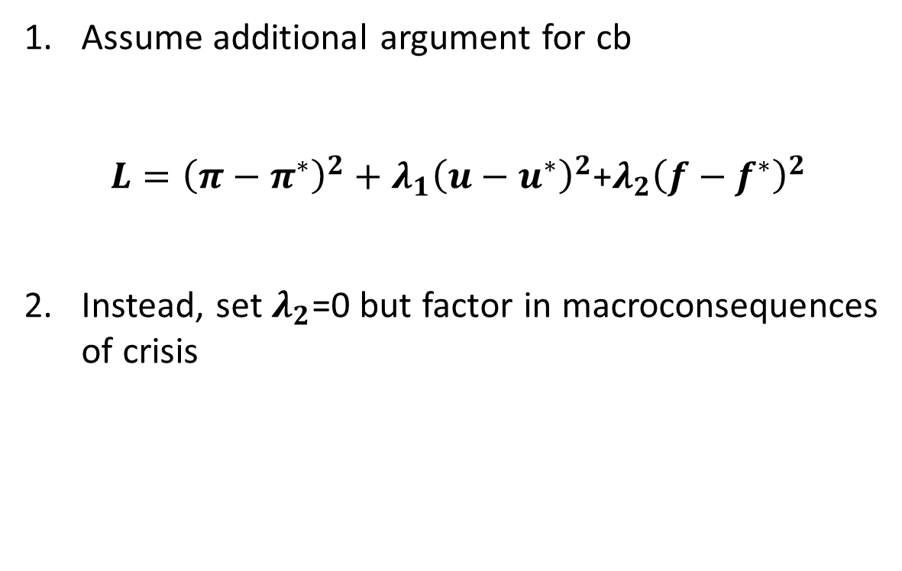
Two alternatives
Assume additional argument for cb
${L=\left(π−π^{∗}\right)}^{2}+λ_{1}{\left(u−u^{∗}\right)}^{2}$+${λ_{2}\left(f−f^{∗}\right)}^{2}$
Instead, set $λ_{2}$=0 but factor in macroconsequences of crisis

Slide 20
Empirical cost-benefit analysis
Svensson (2015)
k

Slide 21
Policy problem
How to quantitatively weigh risks against ”normal” monetary policy considerations
Costs: tighter MP reduces inflation and raises unemployment
Benefits: but also leads to lower risk of crisis
  Svensson assumes that crisis means 5% addition to unemployment

Slide 22
Benefits: Tighter MP can reduce risks
Monetary
policy
Real debt
accumulation
Likelihood of crisis
Quantified via VAR model
Quantified via Schularick and Taylor, AER 2012

Slide 23
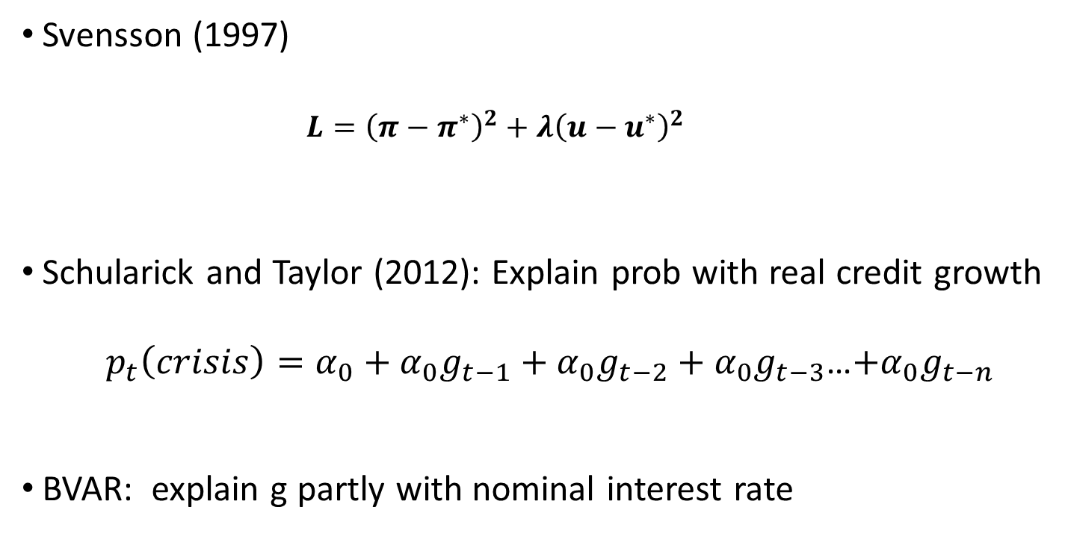
Building blocks
Svensson (1997)
  $${L=\left(π−π^{∗}\right)}^{2}+λ{\left(u−u^{∗}\right)}^{2}$$
Schularick and Taylor (2012): Explain prob with real credit growth
$p_{t}\left(crisis\right)=α_{0}+α_{0}g_{t−1}+α_{0}g_{t−2}+α_{0}g_{t−3}$…$+α_{0}g_{t−n}$
BVAR: explain g partly with nominal interest rate

Slide 24
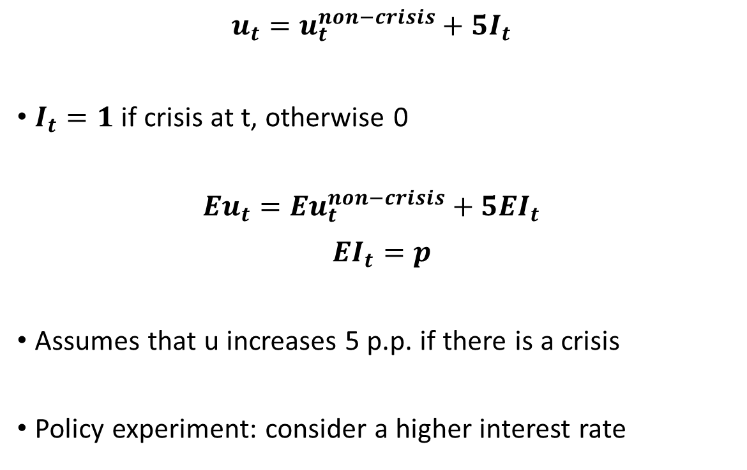
Unemployment depends on crisis
$$u_{t}={u_{t}^{non−crisis}+{5I}_{t}}_{}$$
$I_{t}=1$ if crisis at t, otherwise 0
$$Eu_{t}=E{u_{t}^{non−crisis}+{5EI}_{t}}_{}$$
$${EI}_{t}=p$$
Assumes that u increases 5 p.p. if there is a crisis
Policy experiment: consider a higher interest rate

Slide 25
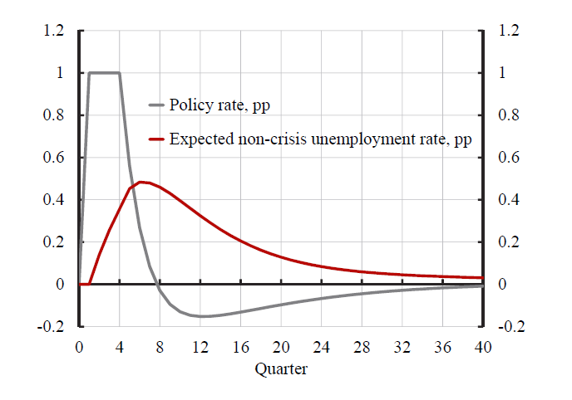
Svenssons experiment: rate hike

Slide 26
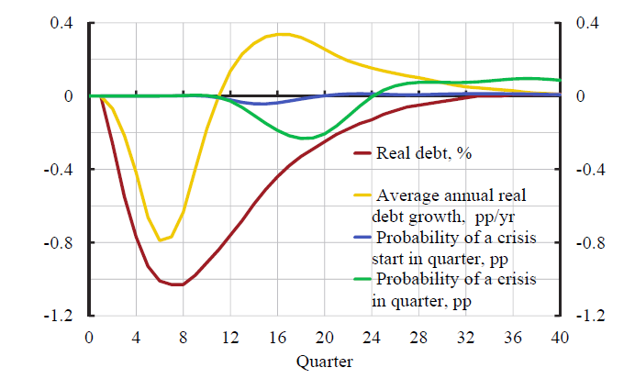
Quantitative benefits

Slide 27
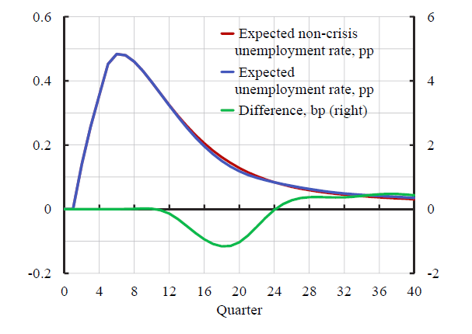
Quantitative costs

Slide 28
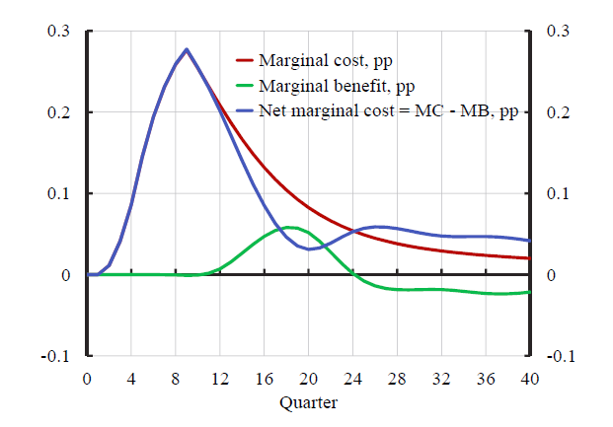
In Svenssons benchmark cal – does not pay to lean against the wind

Slide 29
Conclusions
Room for concern for imbalances within standard flexible inflation targeting
Concern for imbalances aims at achieving sustainable economic developments
Benchmark calibration and example of an economy in recession: short run cost of leaning higher than long-term benefit

Slide 30
Discussion
Rests on expected utility – e.g. robust control would emphasize tails
Other empirical strategies may estimate larger effects from interest rates to debt-growth and p(crisis)
Does not consider permanent output loss of crisis

Slide 31
Discussion
Systematic leaning -> expectational effects
  Need dynamic DSGE version, extend Woodford (2011)?
  Work in Gerali et.al. model, effects of macro pru?
  Allows analysis of steady-state issues like Barro-Gordon etc.
Non-linearities in MP->Credit, Credit->p
  Disaggregated credit analysis focusing on ”bad” credit growth
  Leeper suggest analog to fiscal-limit: house-hold limit…

Slide 32
Effects from interest rates to debt can be larger if misperceptions…
Debt/disposable income, Walentin (2013)

Slide 33
The Swedish policy-debate
Some leaning 2010, 2013, but how much?
Recent experience, inflation gradually lower, no room for concerns for debt growth
Important that the FSA deals with the potential imbalances

Slide 34
Extra

Slide 35
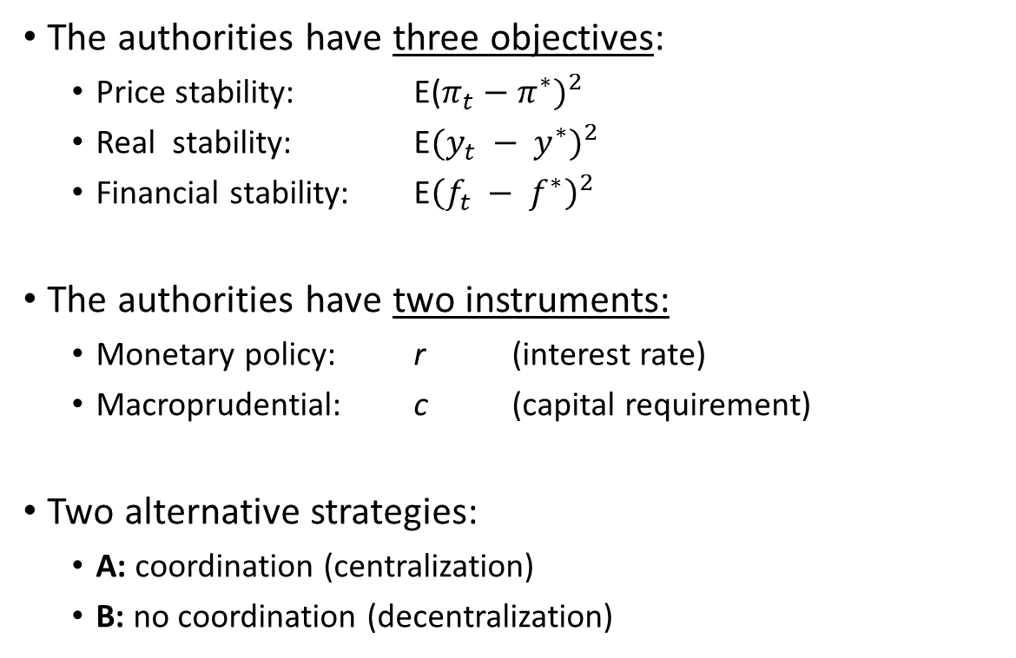
Alternative take: adding financial stability as a separate objective
The authorities have three objectives:
  Price stability: E($π_{t}−π^{∗})^{2}$
  Real stability: E$(y_{t} − y^{∗})^{2}$
  Financial stability: E${\left(f_{t} − f^{∗}\right)}^{2}$
The authorities have two instruments:
  Monetary policy: r (interest rate)
  Macroprudential: c (capital requirement)
Two alternative strategies:
  A: coordination (centralization)
  B: no coordination (decentralization)
Notes:
Smets, F (2013), ”Financial Stability and Monetary Policy: How closely interlinked?”, Sveriges Riksbank Economic Review 2013:3
Cecchetti, S G and M Kohler (2012), ”When capital adequacy and interest rate policy are substitutes (and when they are not)”, BIS Working Papers No 279
Bryant, R C, D W Henderson and T Becker (2012), ”Maintaining Financial Stability in an Open Economy: Sweden in the Global Crisis and Beyond”, SNS Förlag.

Slide 36
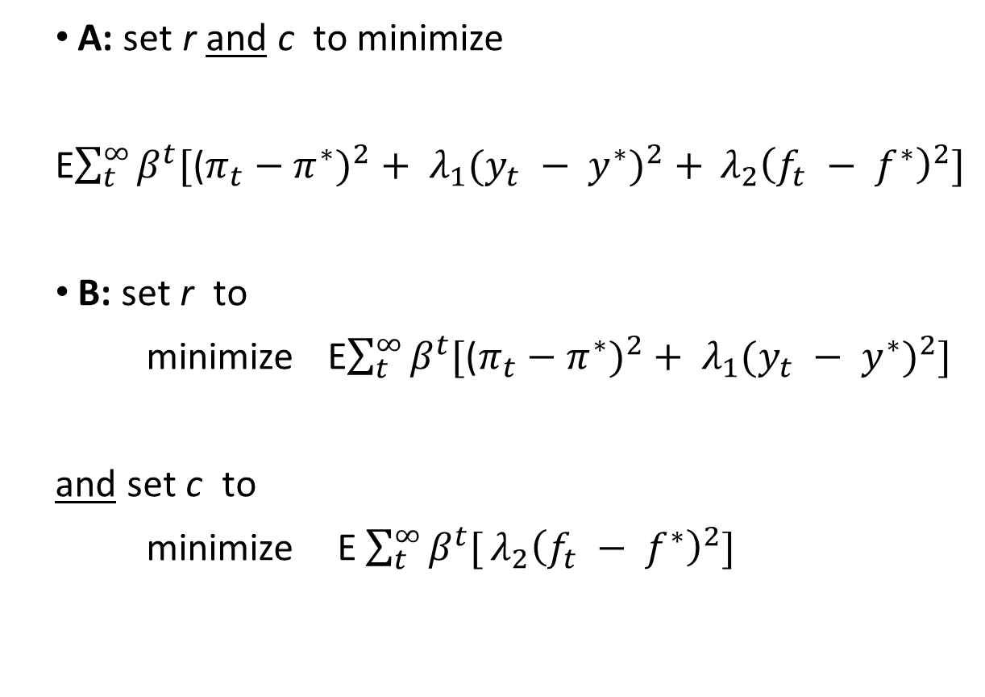
Two alternative strategies
A: set r and c to minimize
E$\sum_{t}^{∞}{β^{t}[\text{(}π_{t}−π^{∗})^{2}+ λ_{1}(y_{t} − y^{∗})^{2}+} λ_{2}{\left(f_{t} − f^{∗}\right)}^{2}]$
B: set r to
minimize E$\sum_{t}^{∞}{β^{t}[\text{(}π_{t}−π^{∗})^{2}+ λ_{1}(y_{t} − y^{∗})^{2}]}$
and set c to
minimize E$\sum_{t}^{∞}{β^{t}[}λ_{2}{\left(f_{t} − f^{∗}\right)}^{2}]$
Notes:
Theoretical arguments for an objective function with three arguments are presented in:
Woodford, M (2012), ”Inflation Targeting and Financial Stability”, Sveriges Riksbank Economic Review 2012:1.

Slide 37
Two alternative strategies
A: CB uses both MP and macro-pru to stabilize inflation, economic activity and financial development
B: The central bank uses different instruments for different purposes, or
  central bank has responsibility for monetary policy
  financial stability is delegated to another authority (e.g. an FSA)
Notes:
The Riksbank has analyzed an example where risks of financial instability affect the forecasts of inflation and unemployment ”beyond the forecast horizon”, where the forecast horizon is shorter than infinity. This is consistent with an objective function where the central bank puts no separate weight on financial stability in monetary policy (strategy B). See:
”Financial imbalances in the monetary policy assessment”, Monetary Policy Report, July 2013.

Slide 38
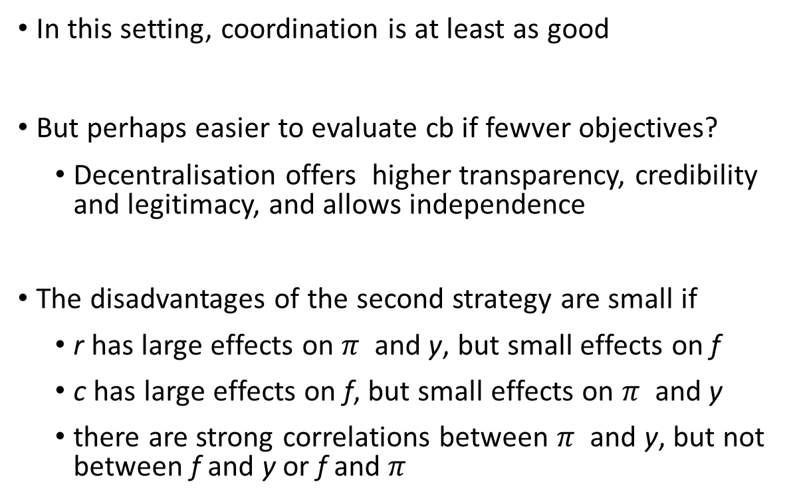
Suggested answers:
In this setting, coordination is at least as good
But perhaps easier to evaluate cb if fewver objectives?
  Decentralisation offers higher transparency, credibility and legitimacy, and allows independence
The disadvantages of the second strategy are small if
  r has large effects on $π$ and y, but small effects on f
  c has large effects on f, but small effects on $π$ and y
  there are strong correlations between $π$ and y, but not between f and y or f and $π$
Notes:
Smets, F (2013), ”Financial Stability and Monetary Policy: How closely interlinked?”, Sveriges Riksbank Economic Review 2013:3
Cecchetti, S G and M Kohler (2012), ”When capital adequacy and interest rate policy are substitutes (and when they are not)”, BIS Working Papers No 279
Bryant, R C, D W Henderson and T Becker (2012), ”Maintaining Financial Stability in an Open Economy: Sweden in the Global Crisis and Beyond”, SNS Förlag.

Slide 39
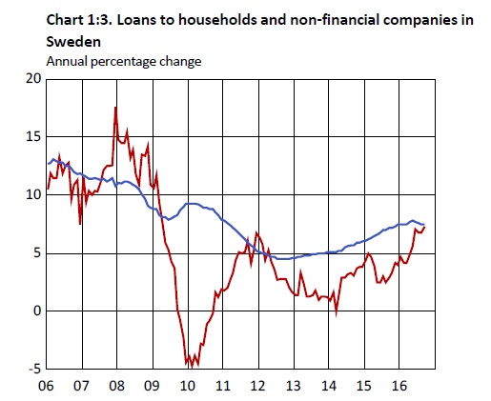
Strong credit-growth to households in Sweden
Households Non-financial firms

